Slide 1
KVM
Lecturer: Ngo Huy Bien
Software Engineering Department
Faculty of Information Technology
University of Science
Ho Chi Minh City, Vietnam
nhbien@fit.hcmus.edu.vn

Slide 2

Objectives

Slide 3

Contents

Slide 4

References

Slide 5
KVM
KVM, an acronym for Kernel-based Virtual Machine is an opensource virtualization technology integrated into the Linux kernel.
It’s a type 1 (bare metal) hypervisor that enables the kernel to act as a bare-metal hypervisor.
KVM allows users to create and run multiple guest machines which can be either Windows or Linux.
Each guest machine runs independently of other virtual machines and the underlying OS ( host system ) and has its own computing resources such as CPU, RAM, network interfaces, and storage.

Slide 6
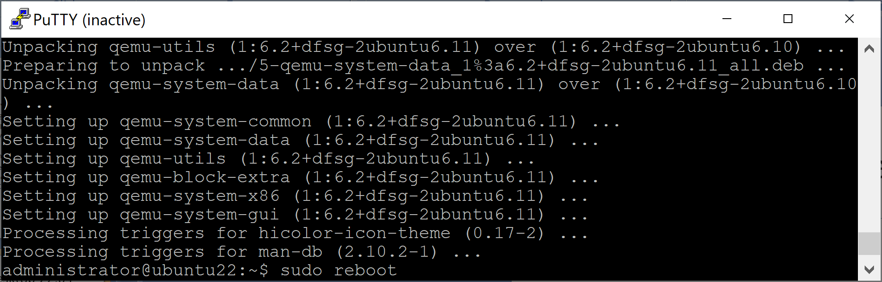
1. Update Ubuntu Desktop 22.04
sudo apt update
sudo apt -y upgrade
sudo reboot

Slide 7
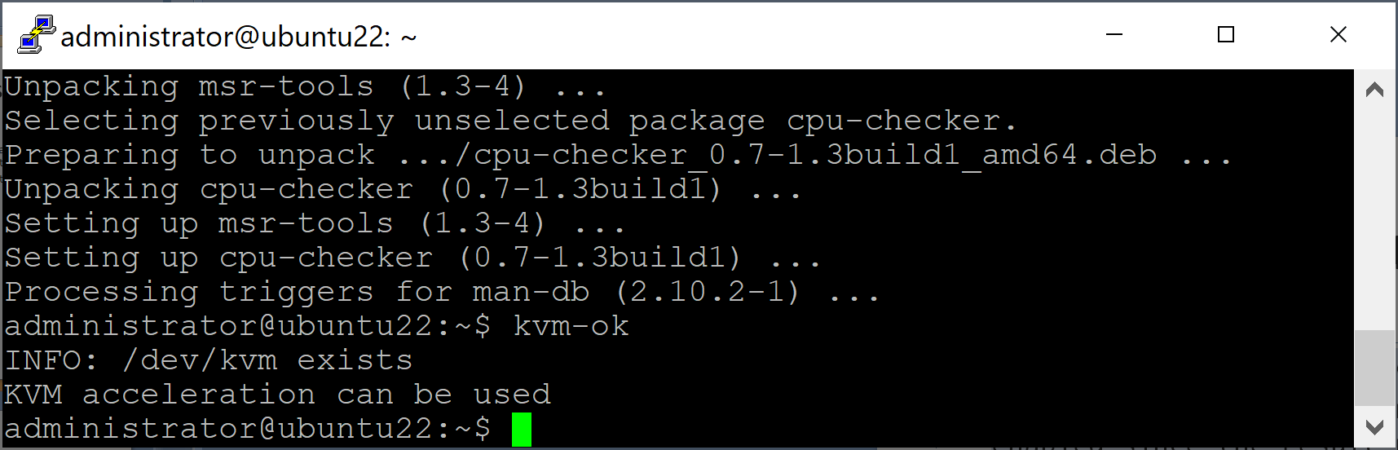
2. Check if Virtualization is enabled
egrep -c '(vmx|svm)' /proc/cpuinfo
# From the output, you can deduce that virtualization is enabled since the result printed is greater than 0.
# If virtualization is not enabled, be sure to enable the virtualization feature in your system’s BIOS settings.
sudo apt install cpu-checker
# Verify if KVM virtualization is enabled
kvm-ok

Slide 8
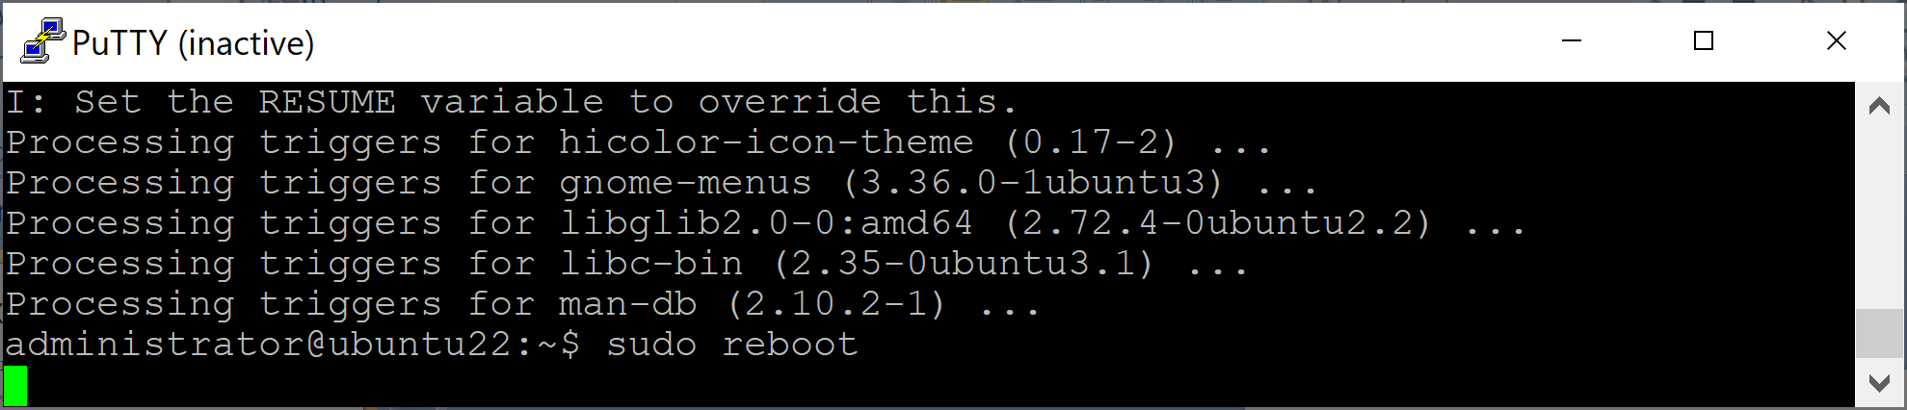
3. Install KVM on Ubuntu Desktop
sudo apt install -y qemu-kvm virt-manager libvirt-daemon-system virtinst libvirt-clients bridge-utils
# qemu-kvm – An opensource emulator and virtualization package that provides hardware emulation.
# virt-manager – A Qt-based graphical interface for managing virtual machines via the libvirt daemon.
# libvirt-daemon-system – A package that provides configuration files required to run the libvirt daemon.
# virtinst – A set of command-line utilities for provisioning and modifying virtual machines.
# libvirt-clients – A set of client-side libraries and APIs for managing and controlling virtual machines & hypervisors from the command line.
# bridge-utils – A set of tools for creating and managing bridge devices.
sudo reboot

Slide 9
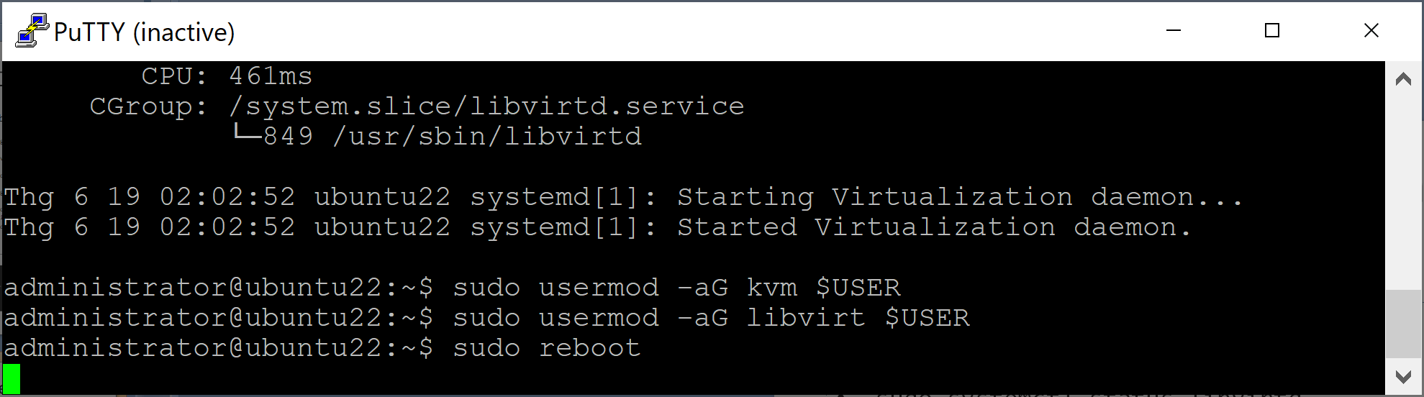
4. Enable the virtualization daemon (libvirtd)
sudo systemctl enable --now libvirtd
sudo systemctl start libvirtd
sudo systemctl status libvirtd
# Add the currently logged-in user to the kvm and libvirt groups so that they can create and manage virtual machines.
sudo usermod -aG kvm $USER
sudo usermod -aG libvirt $USER
sudo reboot

Slide 10
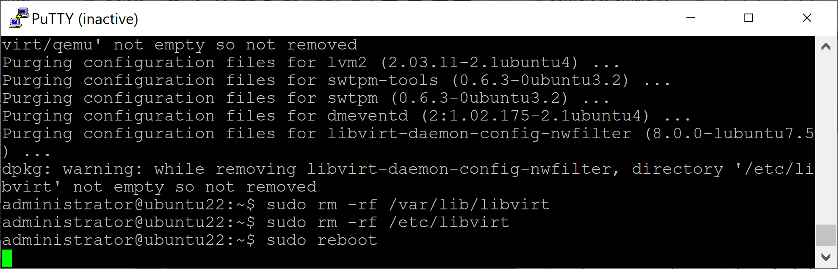
5. Remove KVM
sudo apt remove --purge qemu-kvm virt-manager libvirt-daemon-system virtinst libvirt-clients bridge-utils
sudo apt-get purge --auto-remove qemu-kvm
sudo rm -rf /var/lib/libvirt
sudo rm -rf /etc/libvirt
sudo reboot

Slide 11


Slide 12
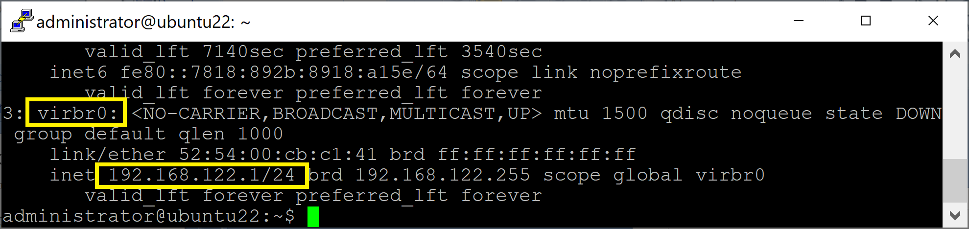
Private Virtual Bridge
A bridged network shares the real network interface of the host computer with other VMs to connect to the outside network. Therefore each VM can bind directly to any available IPv4 or IPv6 addresses, just like a physical computer.
By default KVM setups a private virtual bridge, so that all VMs can communicate with one another, within the host computer. It provides its own subnet and DHCP to configure the guest’s network and uses NAT to access the host network.
ip add show

Slide 13
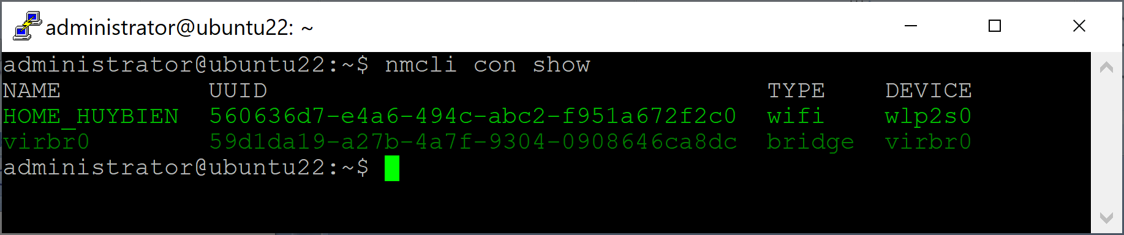
1. Show Connections
nmcli con show

Slide 14
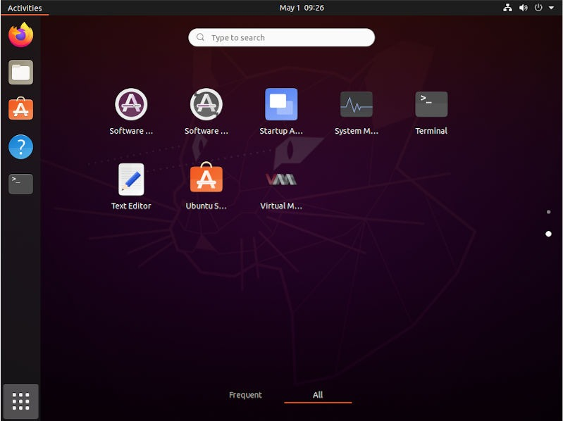
2. Search and Launch Virtual Machine Manager

Slide 16
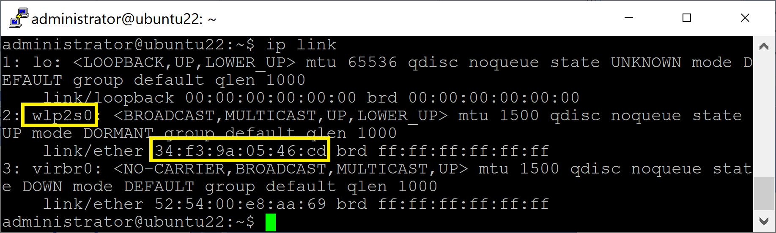
1. Copy Physical NIC Info
ip link
# Copy wlp2s0 and 34:f3:9a:05:46:cd

Slide 17
Bridged networking (aka "shared physical device")
https://wiki.libvirt.org/Networking.html
Important Note: Unfortunately, wireless interfaces cannot be attached to a Linux host bridge, so if your connection to the external network is via a wireless interface ("wlanX"), you will not be able to use this mode of networking for your guests.

Slide 18
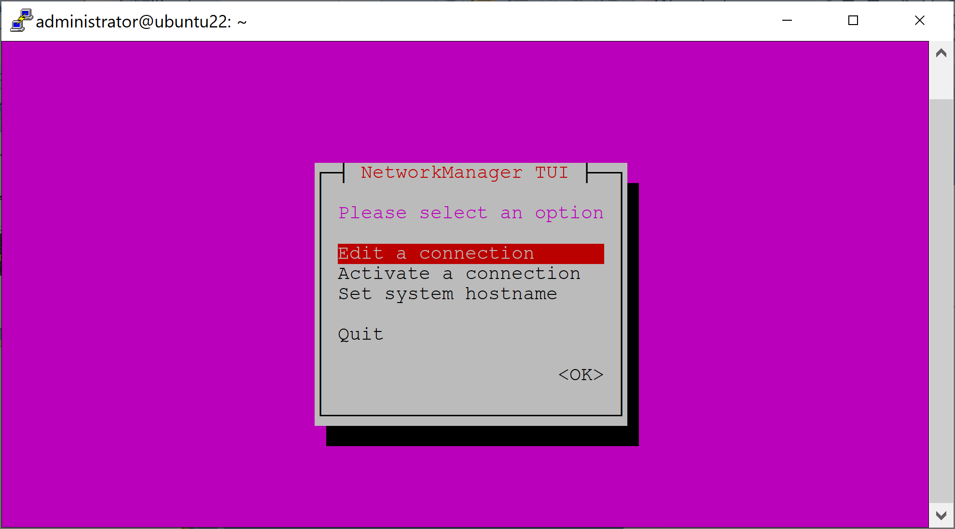
2. Modify Virtual Bridge
sudo nmtui
Important note: Using WI-FI device for virtual bridge is NOT supported.

Slide 19
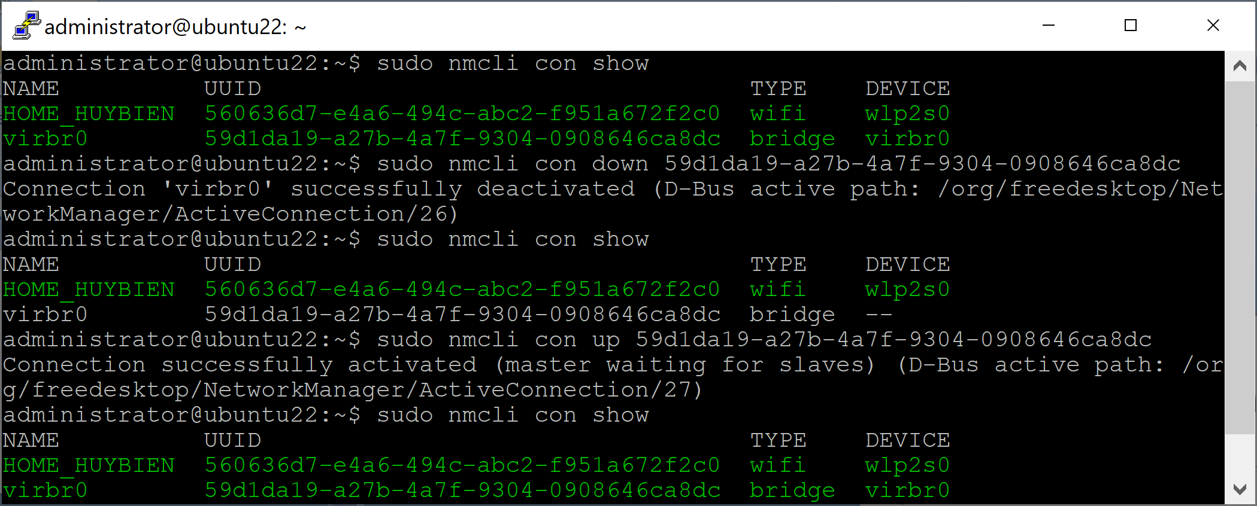
3. Manage Connections
sudo nmcli con show
sudo nmcli con down 59d1da19-a27b-4a7f-9304-0908646ca8dc
sudo nmcli con show
sudo nmcli con up 59d1da19-a27b-4a7f-9304-0908646ca8dc
sudo nmcli con show

Slide 20

Thank You & See You Again

